Slide 1

There is no “I” in

Slide 2

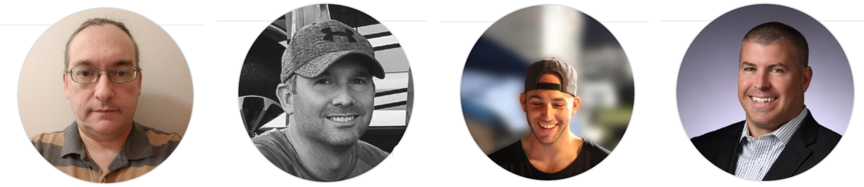
T.E.A.M Members:
T. = Todd Harvey
E. = Ed Fatula
= Andrew Keiser
M. = Mike Sowers

Slide 3

Roles
Todd – Front end dev, styling, and more
Ed – Product design, full stack dev, and more
Andrew – Back end architect, full stack dev, and more
Mike – Server setup, full stack dev, and more

Slide 4


Description of Product:
Our T.E.A.M. has created a video streaming service with the ability to provide both free and premium content, allowing new and established brands to grow their market.

Slide 5

Technologies
React
GraphQL
Mongo
Semantic UI
Semantic UI React
Heroku
Stripe
HTML
CSS
Node
Express
Javascript
Socket.io
React Player

Slide 6

Challenges
Understanding how to integrate video
Integrating Stripe payment for premium content & restricting viewers
Ensuring everyone on the team has challenging pieces of the project
PWA (Progressive Web App)

Slide 7

Successes
Produced a unique product outside of the expertise of our instructor support (no safety net)
Provided the ability to leverage free and paid data
Worked well as a team

Slide 8

Add video or link

Slide 9
Future Enhancements
Provide the streaming service for content control
Enhanced search features
Reply to comments or chat per event
Comments in full screen video
Follow users/channels
Direct message users
Progressive Web App
Category buttons
Require a video link when creating events

Slide 10

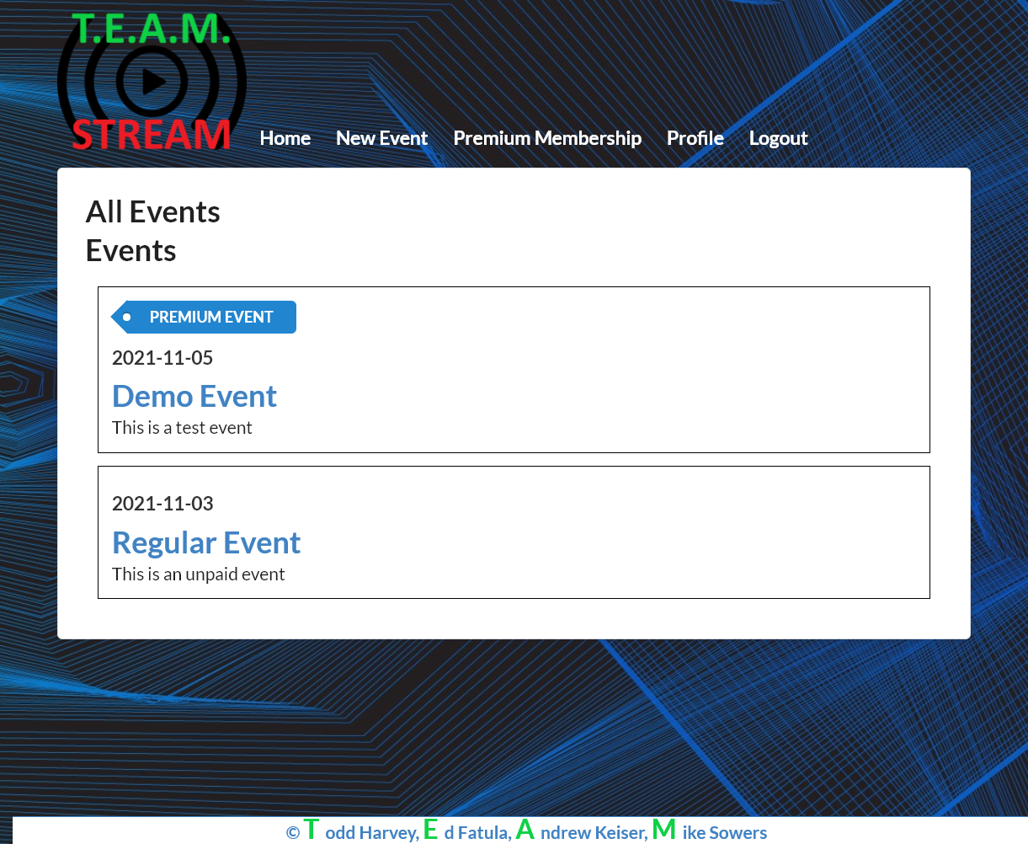

Project Links
Github
Heroku

